Slide 1
MATH-234 Multivariable Calculus
Dr. Atifa Kanwal
Office # A-213
atifa.kanwal@seecs.edu.pk

Slide 2
CYLINDERS AND QUADRIC SURFACES
SECTION 12.6
THOMAS CALCULUS 14TH/11th EDITION

Slide 3
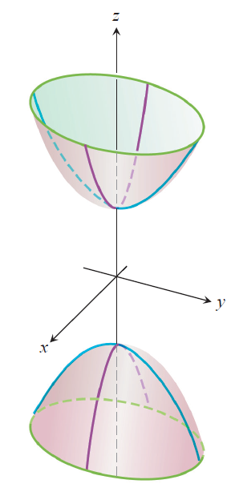
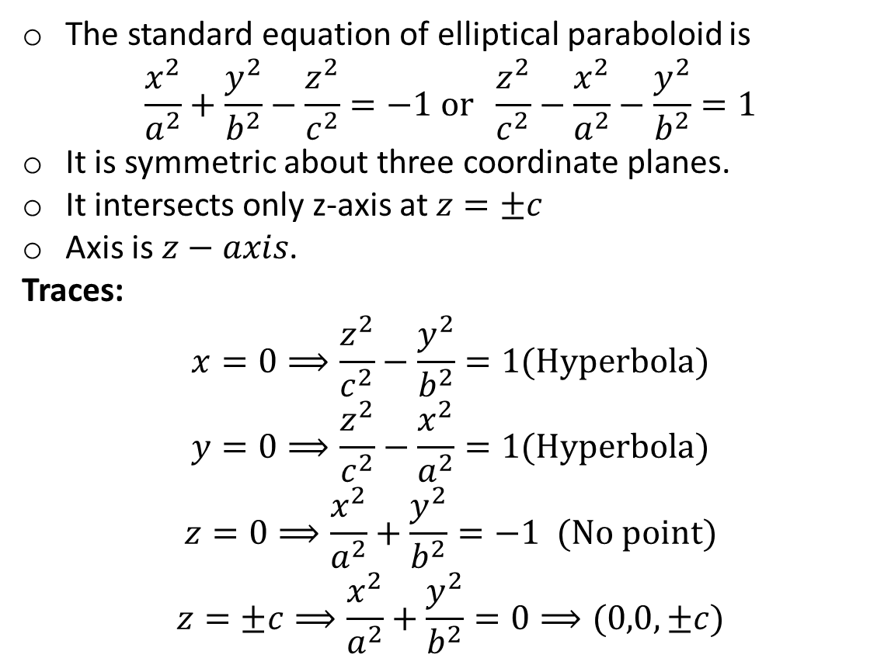
Hyperboloid of two sheets
The standard equation of elliptical paraboloid is
$$\frac{x^{2}}{a^{2}}+\frac{y^{2}}{b^{2}}−\frac{z^{2}}{c^{2}}=−1 or \frac{z^{2}}{c^{2}}−\frac{x^{2}}{a^{2}}−\frac{y^{2}}{b^{2}}=1$$
It is symmetric about three coordinate planes.
It intersects only z-axis at $z=±c$
Axis is $z−axis$.
Traces:
$$x=0⟹\frac{z^{2}}{c^{2}}−\frac{y^{2}}{b^{2}}=1(Hyperbola)$$
$$y=0⟹\frac{z^{2}}{c^{2}}−\frac{x^{2}}{a^{2}}=1(Hyperbola)$$
$$z=0⟹\frac{x^{2}}{a^{2}}+\frac{y^{2}}{b^{2}}=−1 (No point)$$
$$z=±c⟹\frac{x^{2}}{a^{2}}+\frac{y^{2}}{b^{2}}=0⟹(0,0,±c)$$

Slide 4
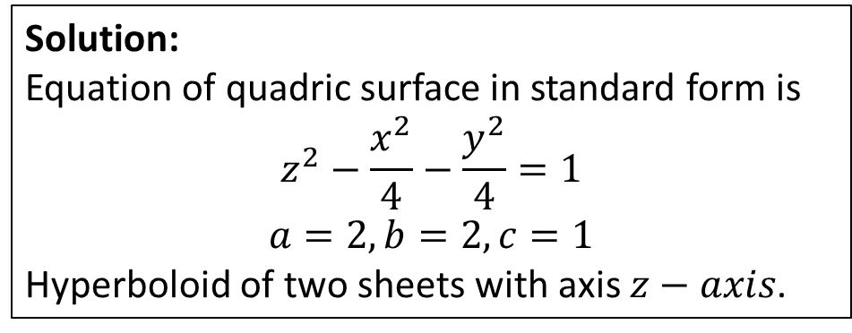
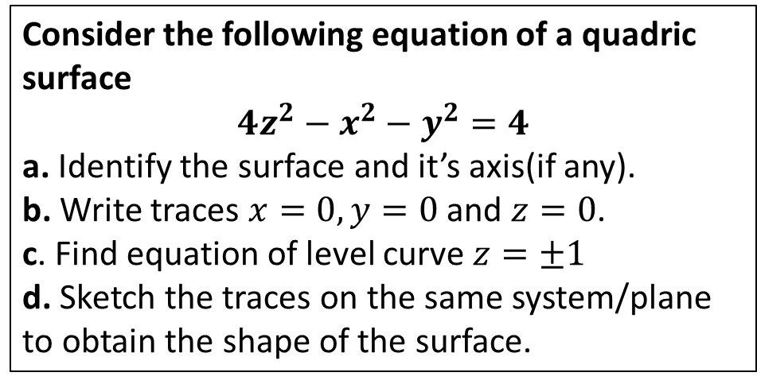
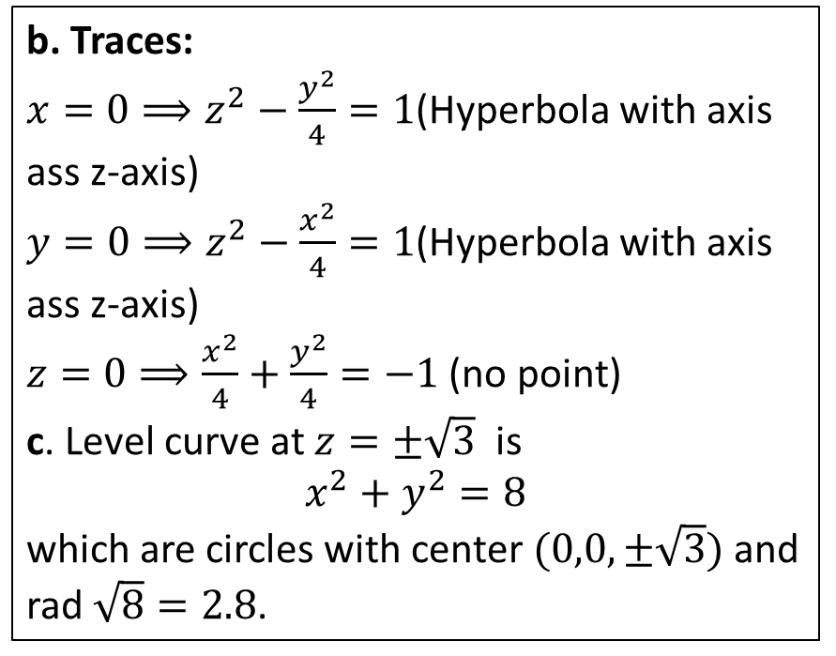
Example:
Consider the following equation of a quadric surface
$$4z^{2}−x^{2}−y^{2}=4$$
a. Identify the surface and it’s axis(if any).
b. Write traces $x=0,y=0$ and $z=0$.
c. Find equation of level curve $z=±1$
d. Sketch the traces on the same system/plane to obtain the shape of the surface.
b. Traces:
$x=0⟹z^{2}−\frac{y^{2}}{4}=1$(Hyperbola with axis ass z-axis)
$y=0⟹z^{2}−\frac{x^{2}}{4}=1$(Hyperbola with axis ass z-axis)
$z=0⟹\frac{x^{2}}{4}+\frac{y^{2}}{4}=−1$ (no point)
c. Level curve at $z=±\sqrt{3}$ is
$$x^{2}+y^{2}=8$$
which are circles with center $(0,0,±\sqrt{3})$ and rad $\sqrt{8}=2.8$.
Solution:
Equation of quadric surface in standard form is
$$z^{2}−\frac{x^{2}}{4}−\frac{y^{2}}{4}=1$$
$$a=2,b=2, c=1$$
Hyperboloid of two sheets with axis $z−axis$.

Slide 5
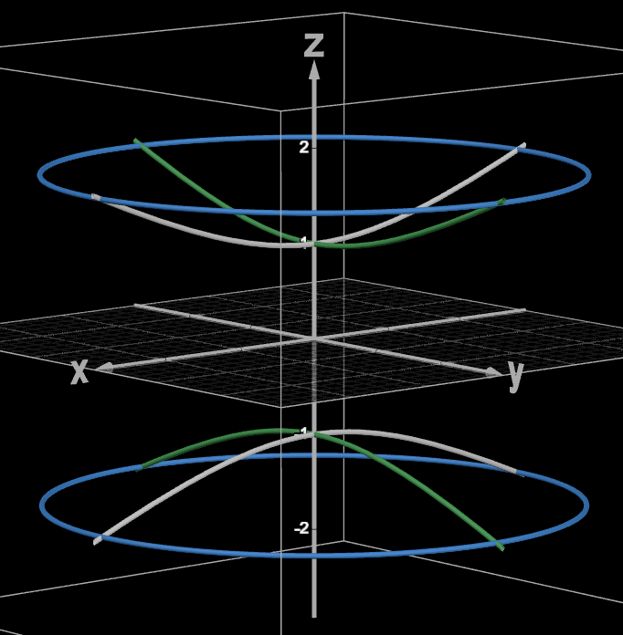

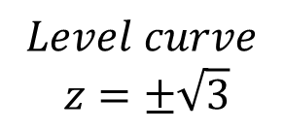

$$Level curve$$
$$z=±\sqrt{3}$$
$$yz−plane$$
$$xz−plane$$

Slide 6
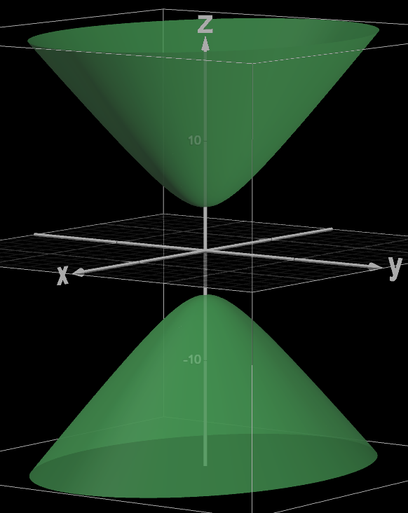
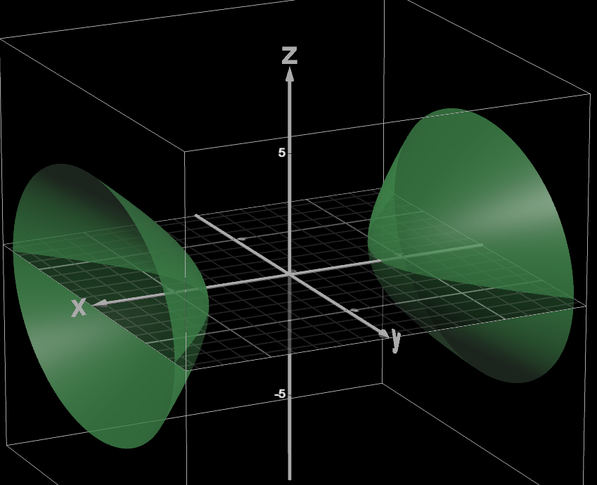
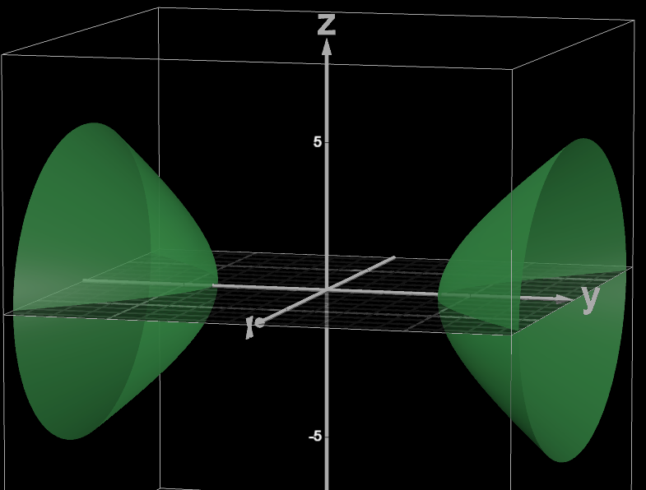
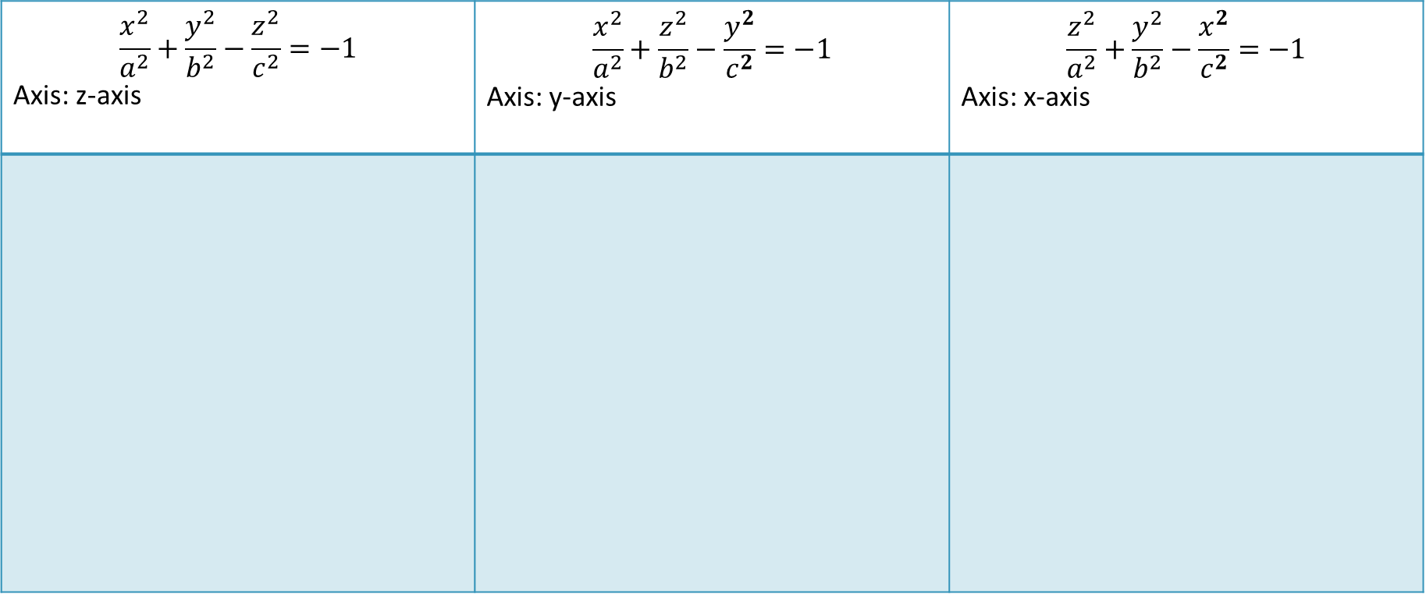
$$\frac{x^{2}}{a^{2}}+\frac{y^{2}}{b^{2}}−\frac{z^{2}}{c^{2}}=−1$$ Axis: z-axis | $$\frac{x^{2}}{a^{2}}+\frac{z^{2}}{b^{2}}−\frac{y^{2}}{c^{2}}=−1$$ Axis: y-axis | $$\frac{z^{2}}{a^{2}}+\frac{y^{2}}{b^{2}}−\frac{x^{2}}{c^{2}}=−1$$ Axis: x-axis

Slide 7
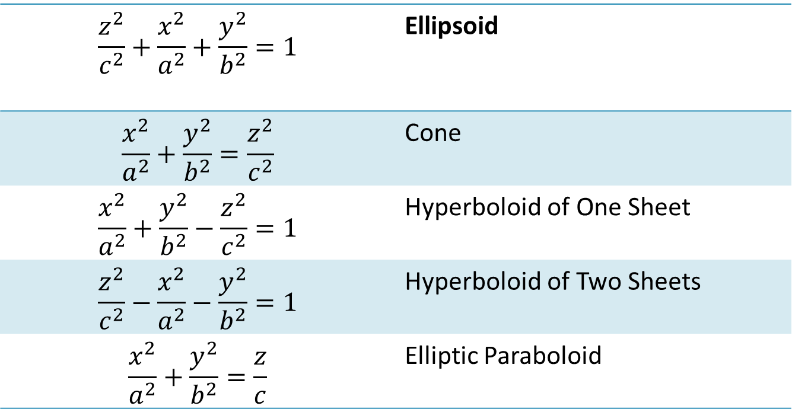
Quadric Surfaces Overview
$$\frac{z^{2}}{c^{2}}+\frac{x^{2}}{a^{2}}+\frac{y^{2}}{b^{2}}=1$$ | Ellipsoid
$$\frac{x^{2}}{a^{2}}+\frac{y^{2}}{b^{2}}=\frac{z^{2}}{c^{2}}$$ | Cone
$$\frac{x^{2}}{a^{2}}+\frac{y^{2}}{b^{2}}−\frac{z^{2}}{c^{2}}=1$$ | Hyperboloid of One Sheet
$$\frac{z^{2}}{c^{2}}−\frac{x^{2}}{a^{2}}−\frac{y^{2}}{b^{2}}=1$$ | Hyperboloid of Two Sheets
$$\frac{x^{2}}{a^{2}}+\frac{y^{2}}{b^{2}}=\frac{z}{c}$$ | Elliptic Paraboloid

Slide 8
Limits and Continuity in Higher Dimensions
Section 14.2
Thomas calculus 14th edition

Slide 9
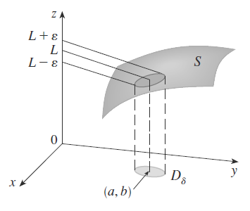
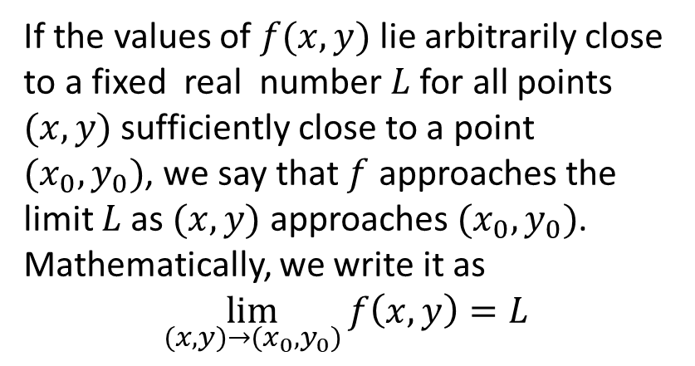
Limits for Functions of Two Variables
Definition
If the values of $f(x,y)$ lie arbitrarily close to a fixed real number $L$ for all points $(x,y)$ sufficiently close to a point $(x_{0},y_{0})$, we say that $f$ approaches the limit $L$ as $(x,y)$ approaches $(x_{0},y_{0})$. Mathematically, we write it as
$$\lim_{(x,y)→(x_{0},y_{0})}{f\left(x,y\right)}=L$$

Slide 10
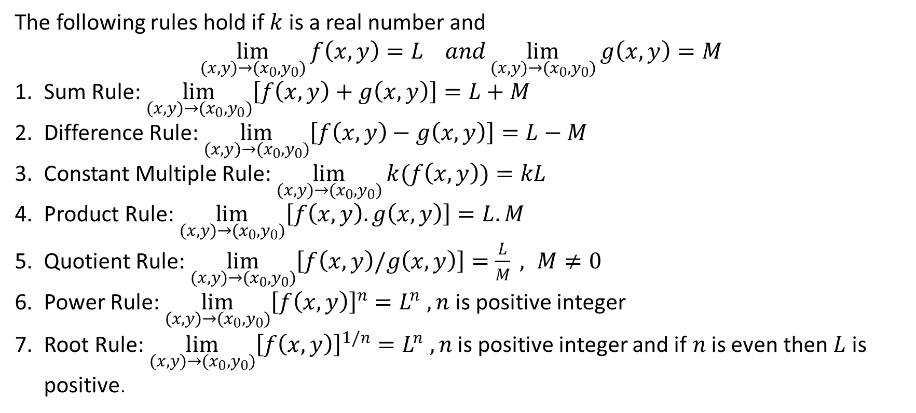
Properties of Limits of Functions of Two Variables
The following rules hold if $k$ is a real number and
$$\lim_{(x,y)→(x_{0},y_{0})}{f\left(x,y\right)}=L and\lim_{(x,y)→(x_{0},y_{0})}{g\left(x,y\right)}=M$$
Sum Rule: $\lim_{(x,y)→(x_{0},y_{0})}\left[f\left(x,y\right)+g\left(x,y\right)\right]=L+M$
Difference Rule: $\lim_{(x,y)→(x_{0},y_{0})}\left[f\left(x,y\right)−g\left(x,y\right)\right]=L−M$
Constant Multiple Rule: $\lim_{(x,y)→(x_{0},y_{0})}{k(f\left(x,y\right))}=kL$
Product Rule: $\lim_{(x,y)→(x_{0},y_{0})}\left[f\left(x,y\right).g\left(x,y\right)\right]=L.M$
Quotient Rule: $\lim_{(x,y)→(x_{0},y_{0})}\left[f\left(x,y\right)/g\left(x,y\right)\right]=\frac{L}{M} , M≠0$
Power Rule: $\lim_{(x,y)→(x_{0},y_{0})}{{\left[f\left(x,y\right)\right]}^{n}}=L^{n} , n$is positive integer
Root Rule: $\lim_{(x,y)→(x_{0},y_{0})}{{\left[f\left(x,y\right)\right]}^{1/n}}=L^{n} , n$is positive integer and if$n$is even then $L$is positive.

Slide 11
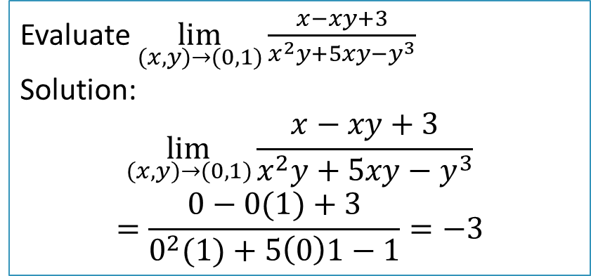
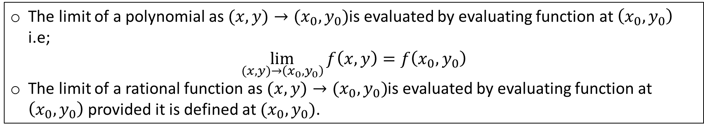
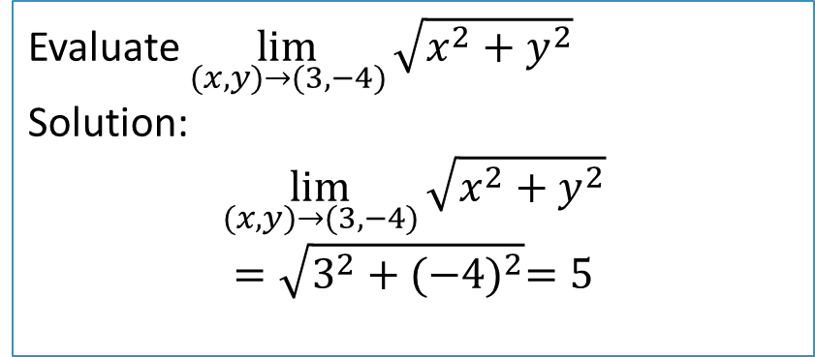
Limits of Polynomials and Rational Functions
The limit of a polynomial as $(x,y)→(x_{0},y_{0})$is evaluated by evaluating function at $\left(x_{0},y_{0}\right)$ i.e;
$$\lim_{(x,y)→\left(x_{0},y_{0}\right)}{f\left(x,y\right)}=f\left(x_{0},y_{0}\right)$$
The limit of a rational function as $(x,y)→(x_{0},y_{0})$is evaluated by evaluating function at $\left(x_{0},y_{0}\right)$ provided it is defined at $(x_{0},y_{0})$.
Example 1:
Example 2:
Evaluate $\lim_{(x,y)→(0,1)}{\frac{x−xy+3}{x^{2}y+5xy−y^{3}}}$
Solution:
$$\lim_{(x,y)→(0,1)}{\frac{x−xy+3}{x^{2}y+5xy−y^{3}}}$$
$$=\frac{0−0(1)+3}{0^{2}(1)+5\left(0\right)1−1}=−3$$
Evaluate $\lim_{(x,y)→(3,−4)}{\sqrt{x^{2}+y^{2}}}$
Solution:
$$\lim_{(x,y)→(3,−4)}{\sqrt{x^{2}+y^{2}}}$$
$$=\sqrt{3^{2}+{(−4)}^{2}}=5$$

Slide 12
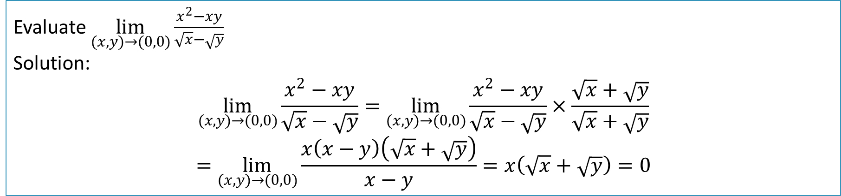
Evaluating limits with zero denominator: If both numerator and denominator tend to zero then zero denominator can be eliminated by factorization or rationalization.
Example 3:
Evaluate $\lim_{(x,y)→(0,0)}{\frac{x^{2}−xy}{\sqrt{x}−\sqrt{y}}}$
Solution:
$$\lim_{(x,y)→(0,0)}{\frac{x^{2}−xy}{\sqrt{x}−\sqrt{y}}}=\lim_{(x,y)→(0,0)}{\frac{x^{2}−xy}{\sqrt{x}−\sqrt{y}}}×\frac{\sqrt{x}+\sqrt{y}}{\sqrt{x}+\sqrt{y}}$$
$$=\lim_{(x,y)→(0,0)}{\frac{x\left(x−y\right)\left(\sqrt{x}+\sqrt{y}\right)}{x−y}}=x\left(\sqrt{x}+\sqrt{y}\right)=0$$

Slide 13
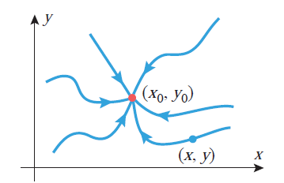
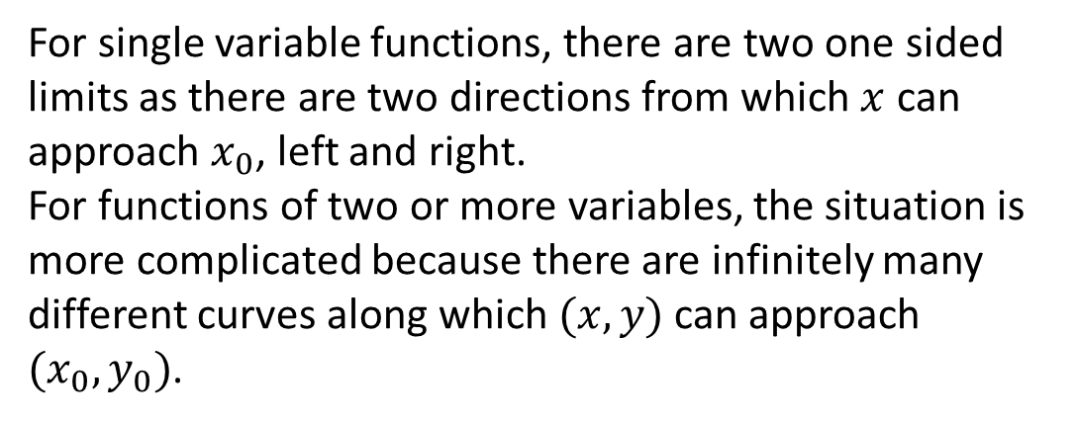
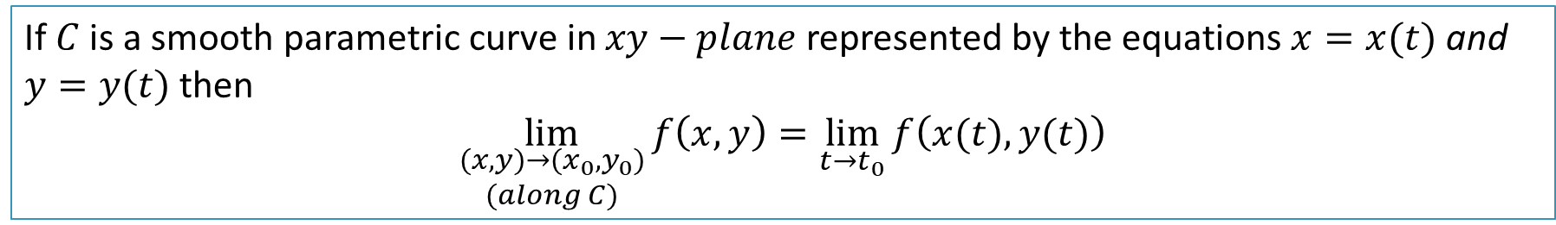
Limits Along Curves
For single variable functions, there are two one sided limits as there are two directions from which $x$ can approach $x_{0}$, left and right.
For functions of two or more variables, the situation is more complicated because there are infinitely many different curves along which $(x,y)$ can approach $(x_{0},y_{0})$.
If $C$ is a smooth parametric curve in $xy−plane$ represented by the equations $x=x(t)$ and $y=y(t)$ then
$$\lim_{\begin{aligned}(x,y)→(x_{0},y_{0}) \\ (along C)\end{aligned}}{f\left(x,y\right)}=\lim_{t→t_{0}}{f\left(x(t),y(t)\right)}$$

Slide 14
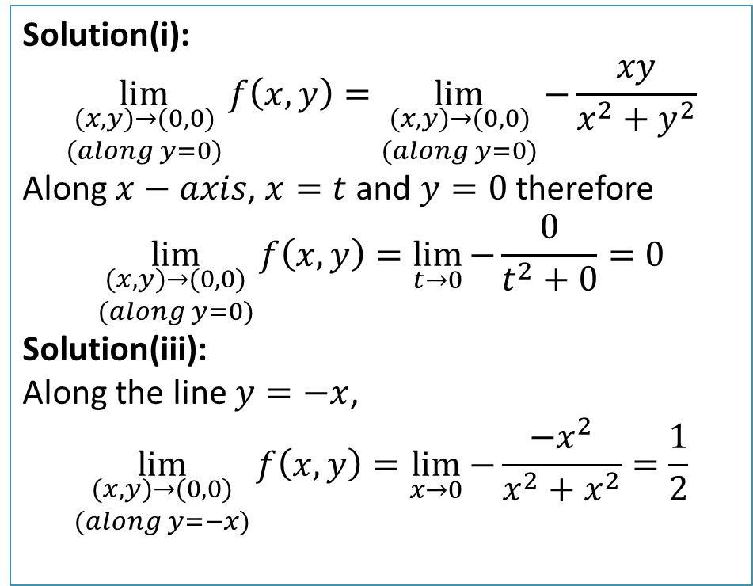
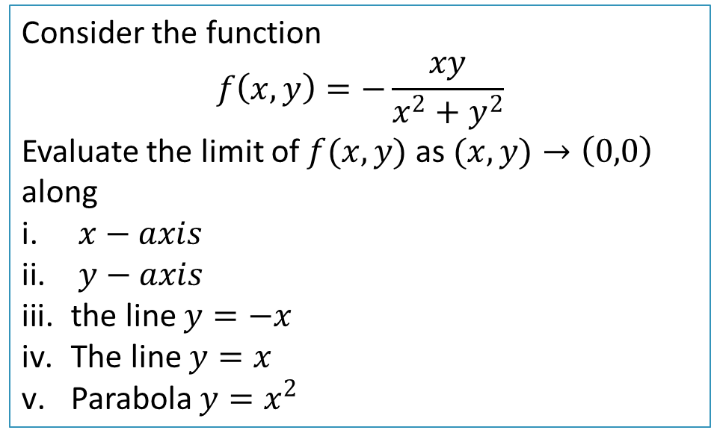
Example 4:
Consider the function
$$f\left(x,y\right)=−\frac{xy}{x^{2}+y^{2}}$$
Evaluate the limit of $f(x,y)$ as $(x,y)→\left(0,0\right)$ along
$x−axis$
$y−axis$
the line $y=−x$
The line $y=x$
Parabola $y=x^{2}$
Solution(i):
$$\lim_{\begin{aligned}(x,y)→(0,0) \\ (along y=0)\end{aligned}}{f\left(x,y\right)}=\lim_{\begin{aligned}(x,y)→(0,0) \\ (along y=0)\end{aligned}}{−\frac{xy}{x^{2}+y^{2}}}$$
Along $x−axis$, $x=t$ and $y=0$ therefore
$$\lim_{\begin{aligned}(x,y)→(0,0) \\ (along y=0)\end{aligned}}{f\left(x,y\right)}=\lim_{t→0}{−\frac{0}{t^{2}+0}}=0$$
Solution(iii):
Along the line $y=−x$,
$$\lim_{\begin{aligned}(x,y)→(0,0) \\ (along y=−x)\end{aligned}}{f\left(x,y\right)}=\lim_{x→0}{−\frac{−x^{2}}{x^{2}+x^{2}}}=\frac{1}{2}$$

Slide 15
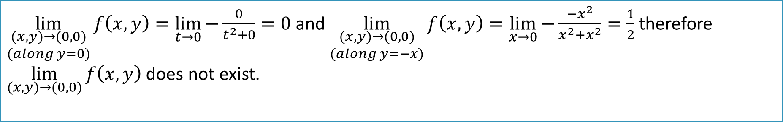
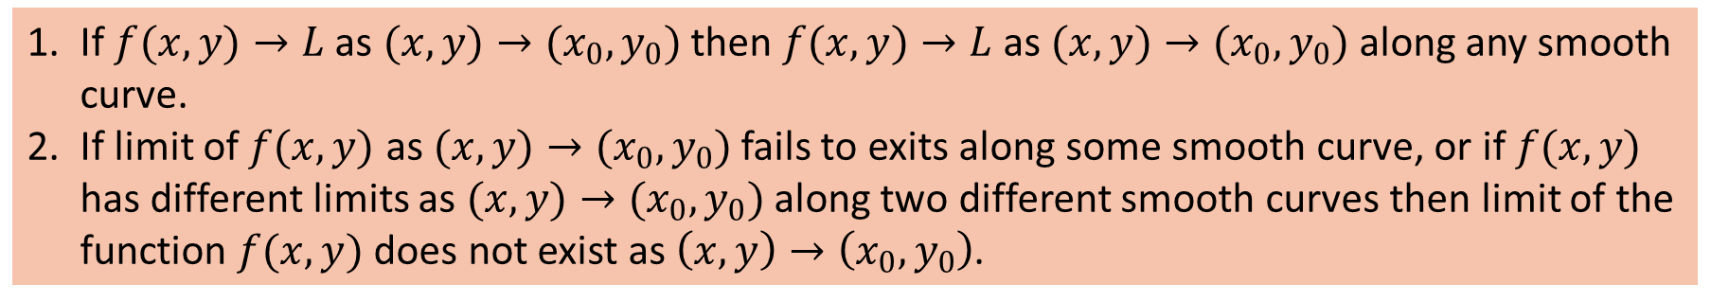
Relationship between General Limits and Limits along Smooth Curves
If $f(x,y)→L$ as $(x,y)→(x_{0},y_{0})$ then $f(x,y)→L$ as $(x,y)→(x_{0},y_{0})$ along any smooth curve.
If limit of $f(x,y)$ as $(x,y)→(x_{0},y_{0})$fails to exits along some smooth curve, or if $f(x,y)$ has different limits as $(x,y)→(x_{0},y_{0})$ along two different smooth curves then limit of the function $f(x,y)$ does not exist as $\left(x,y\right)→\left(x_{0},y_{0}\right)$.
In Example 4:
$\lim_{\begin{aligned}(x,y)→(0,0) \\ (along y=0)\end{aligned}}{f\left(x,y\right)}=\lim_{t→0}{−\frac{0}{t^{2}+0}}=0$ and $\lim_{\begin{aligned}(x,y)→(0,0) \\ (along y=−x)\end{aligned}}{f\left(x,y\right)}=\lim_{x→0}{−\frac{−x^{2}}{x^{2}+x^{2}}}=\frac{1}{2}$ therefore $\lim_{(x,y)→(0,0)}{f\left(x,y\right)}$ does not exist.

Slide 16
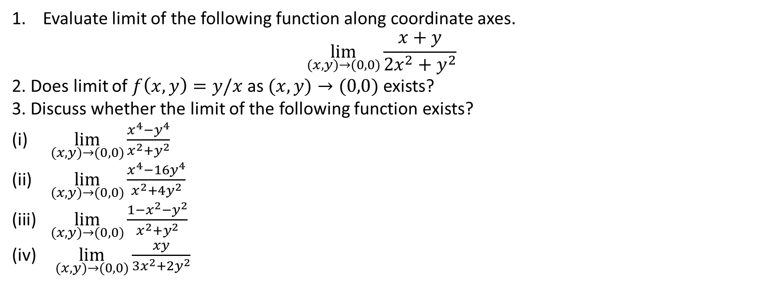
Practice Questions:
Evaluate limit of the following function along coordinate axes.
$$\lim_{(x,y)→(0,0)}{\frac{x+y}{2x^{2}+y^{2}}}$$
2. Does limit of $f\left(x,y\right)=y/x$ as $(x,y)→(0,0)$ exists?
3. Discuss whether the limit of the following function exists?
$\lim_{(x,y)→(0,0)}{\frac{x^{4}−y^{4}}{x^{2}+y^{2}}}$
$\lim_{(x,y)→(0,0)}{\frac{x^{4}−16y^{4}}{x^{2}+4y^{2}}}$
$\lim_{(x,y)→(0,0)}{\frac{1−x^{2}−y^{2}}{x^{2}+y^{2}}}$
$\lim_{(x,y)→(0,0)}{\frac{xy}{{3x}^{2}+2y^{2}}}$
Exercise 14.2: Solve relevant questions

